Slide 1



Slide 2
Mississippi Home Corporation
HOME4ALL
HOMEBUYER ASSISTANCE
PROGRAM
Overview
April 4, 2025

Slide 3
Welcome to the Home4All Session
Please complete the ice breaker card.
You may add your first name or initials.
Circle your answers.
When finished return your card to the presenter.

Slide 4
Program Overview

Slide 5
What is the Home4All Program?

Slide 6
Program Goals
Provide decent, safe, and affordable housing to low-income households.
Provide a homebuyer with a lower, competitive interest rate offered through the Mortgage Revenue Bond (MRB7) Program.
The Home4All program is designed to assist individuals with low incomes in becoming homeowners by providing up to $25,000 for:
down payment assistance
closing costs
principal reduction
housing counseling services

Slide 7

Affirmatively Marketing Outreach
HOME4All must be committed to an Affirmative Action Program: Develop and implement written Affirmative Marketing Outreach Procedures, communication tools, and materials to:
Ensure persons without regard to race, color, creed, ethnicity, religion, sex, age, national origin, familial status, or disability, know how to obtain access to assistance and ensure effective communication with persons with disabilities.
Consistent with Title VI and Executive Order 13166- Programs and activities for Limited English Proficiency (LEP) persons- Marketing and outreach documentation available in different languages.
Eligible Applicants

Slide 8
What is Fair Housing?
The right to choose housing free from unlawful discrimination.
This Act protects people from discrimination when they are renting or buying a home, getting a mortgage, seeking housing assistance, or engaging in other housing-related activities.
There are 7 protected classes under the Fair Housing Act. (Race, Color, Religion, Sex, Handicap (Disability), Familial Status, and National Origin.

Slide 9
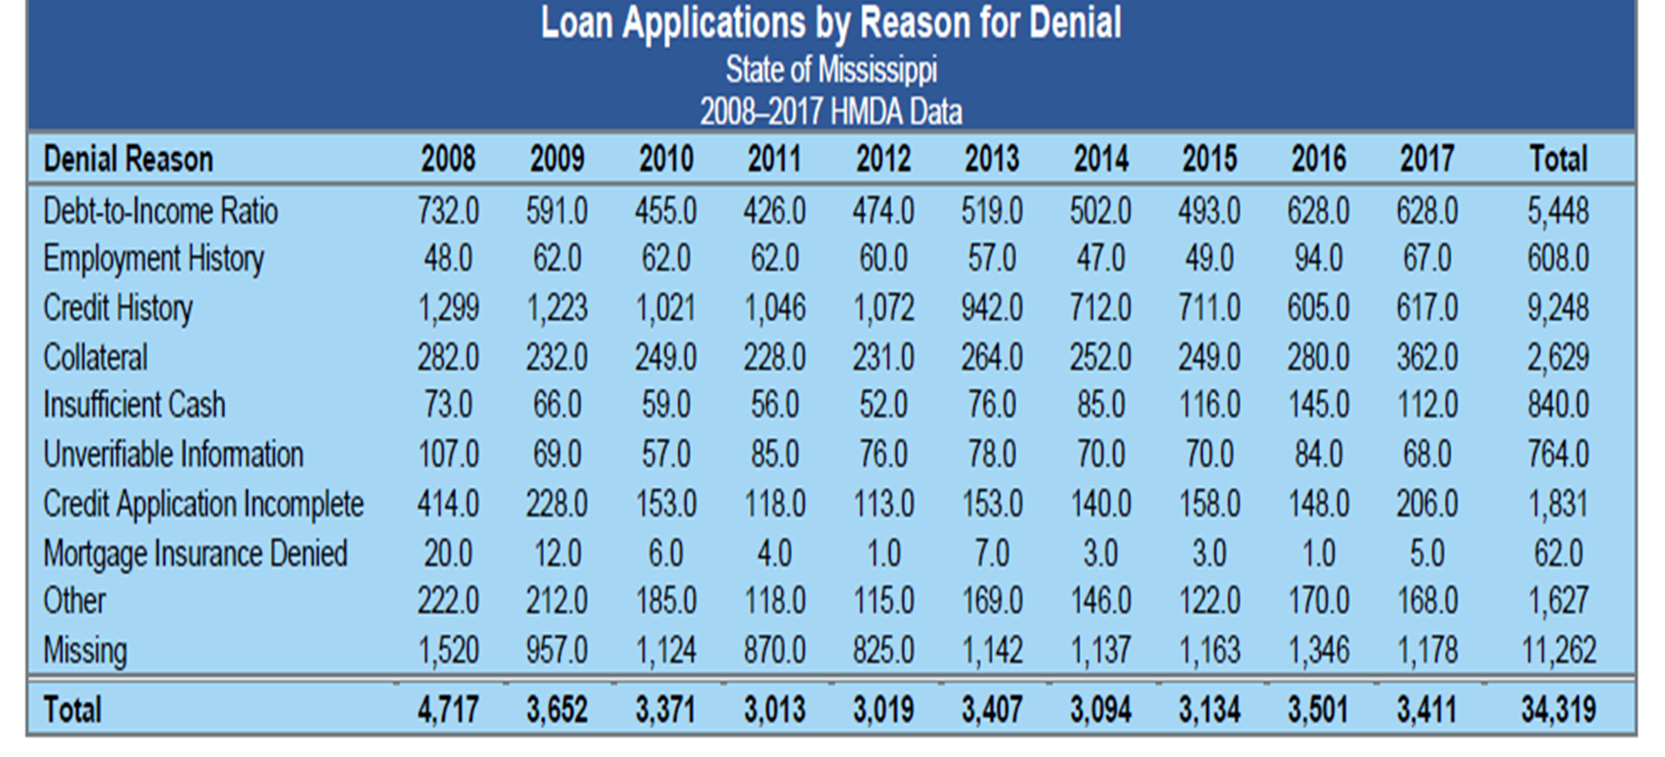



Slide 10
Eligibility
Requirements

Slide 11
Purpose of the HOME4ALL Policy Requirements
Ensure compliance & Achieve Program goals:
  Ensure that buyers can afford homeownership today.
  Buyer is eligible for the program.
  The purchase is affordable & sustainable.
  Ensure ownership is sustainable over time.
  Provide appropriate assistance.
  Avoid excessive costs & foreclosure.
  Affordable + Appropriate + Sustainable = Home4All

Slide 12
The Four Ps of HOME4ALL Compliance
People
Price
Property
Period of Affordability

Slide 13
People
Part -5 Income Determination Method will be used to determine eligibility.
Income from all family members 18 & up will be counted.
Cannot have owned or have had an interest in a principal residence within the past three years.
Must be a U.S. Citizen..
Income can not exceed 80% of AMI.
Property must be the principal residence.
Applicants must qualify as a low-to-moderate household income at the time the housing contract is signed.
Receive pre-purchase counseling.
Debt-to-Income Ratio 30/45
Eligible Applicants

Slide 14
Price
Complete the loan application with the mortgage lender and must be approved for a loan based on the Lender’s underwriting standard.
Individuals are required to meet the credit requirements established by FHA, VA, Rural Development, Freddie Mac, Fannie Mae products.
Property must not exceed 95% of area median value limit, published annually by HUD.
Have a minimum of $500 Cash reserves.
Income can not exceed 80% of AMI.
DPA minimum is $1,000, and maximum is $25,000
Applicants must qualify as a low-to-moderate household income at the time the housing contract is signed.
Total DPA can not exceed 50% of the purchase price of the property.
Provide an appropriate amount of assistance to the Homebuyer.
Eligible Applicants

Slide 15
Property
Single-Family Housing
Leasehold properties that meet the requirements of HUD.
Must meet Property Standards at time of purchase
Condominiums
Manufactured Homes that are permanently fixed to land.
Must be affordable & sustainable.
The mortgage loan must be for the permanent financing of a residence located within the state of Mississippi that is being constructed by or on behalf of an eligible borrower and that will remain an owner-occupied residence for the life of the loan until sold or refinanced.
Eligible Applicants

Slide 16
Period of Affordability
Eligible Applicants
Recapture or Resale
Home4all is a recapture provision which enable MHC to collect the subsidy received by the borrower.
Owner-occupancy subject annual monitoring, but no ongoing inspections or income re-certifications.
Less than$15,000 – 5 Years
Greater than $15,000- 10 Years
Homeowner Written Agreement
The period of affordability is the length of time the assisted property is considered HOME-Assisted.

Slide 17
Appropriate Assistance
Sustainability is imperative, it is important to avoid excessive subsidy & determine “reasonable and appropriate” amount of assistance for each buyer individually.
Assistance to specific buyer will vary based on price, buyer circumstances, and available financing.
We have adopted:
Underwriting standards for determining the “gap”
Maximum HOME assistance amounts
Minimum required contributions & front-end ratios

Slide 18
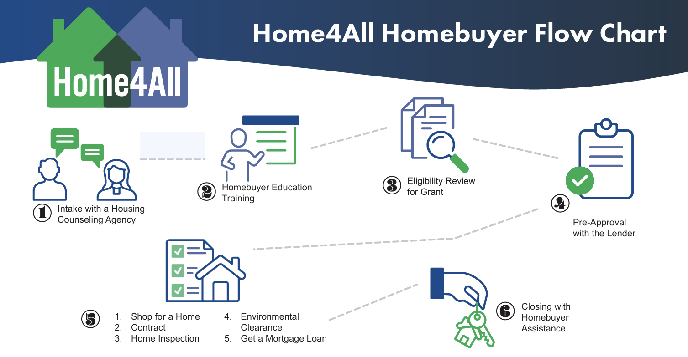

Slide 19
Process
Homebuyer can find a Housing Counselor on MHC website.
Homebuyer contact a Housing Counselor for Pre-Purchase, Application Intake and Homebuyer education class.
Housing Counselor upload all required documents to the MITAS portal. (eligibility package)
MHC Federal Grant review for Pre-Qualification.
Status will update to MHC Pre-Approval.
Housing Counselor Submits the Lender Referral Form.
Reservation number will be assigned to the listed loan originator.
Originator is notified and should begin loan pre-approval process.
Property is identified the Housing Counselor will begin Environmental Review. (signed contract)
MHC Federal Grant will review loan details and complete program underwriting. (HOME Subsidy layering and Reservation of funds.
Single-Family Staff will begin underwriting.
Loan Closing
Post-Closing Documents

Slide 20

Housing Counseling
A HUD Certified Housing Counselor is a housing counselor who has passed the HUD certification examination and works for a HUD-approved housing counseling agency.
The Home4All program requires housing counseling as it provides direct assistance to the homebuyer (ex: Downpayment, closing cost assistance, soft-second mortgage, etc.)
Housing counselors must be certified.
Agencies that receive HUD funds that do not meet the certification requirement must partner with a HUD-approved Housing Counseling Agency.

Slide 21
Housing Counseling
  Homebuyer Education (HBE) is required for all adults listed on the deed of trust (must have their certificate).
  Applicants must complete an 8-hour homebuyer education course and receive housing counseling services appropriate to their needs.
  Group Home Buyer Education is required.
  Applicants with disability hardships may receive alternate modes of in-person counseling.
Unsuccessful applicants may receive a written credit action plan from a housing counselor which provides action to help them with their homeowner goals.

Slide 22
Homebuyer Education Training
Are You Ready to Buy a Home?
Managing Your Money.
Understanding Credit.
Getting A Mortgage Loan.
Shopping for A Home.
Protecting Your Investment.

Slide 23
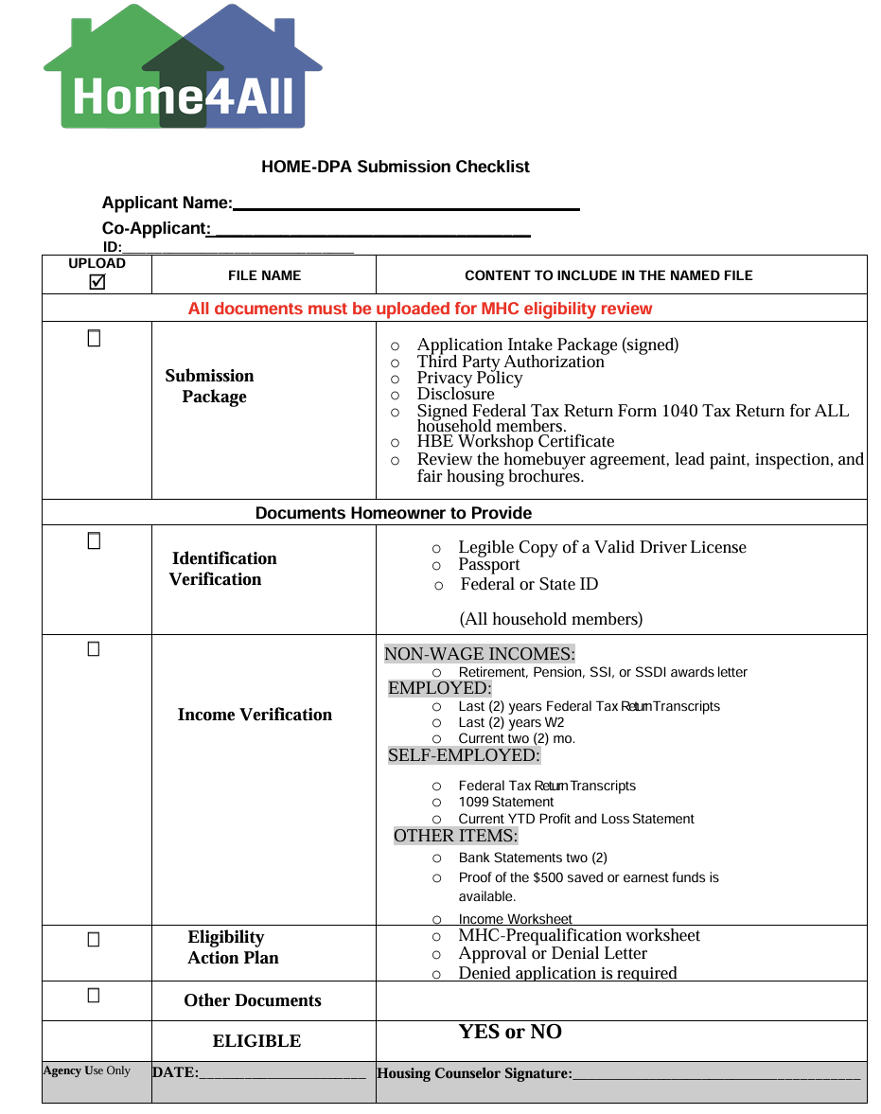

Slide 24
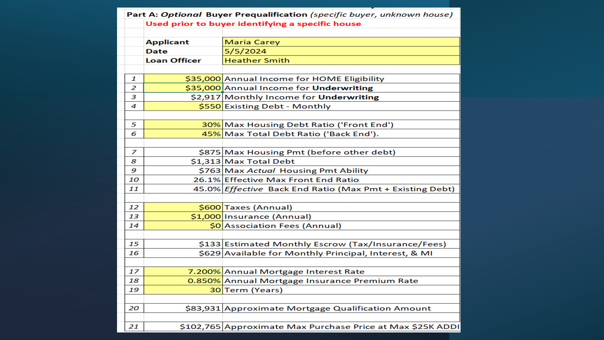

Slide 25
Lender’s Underwriting Policy Provisions
Any prohibited features, for example
Avoid Maximum loan term;
Avoid Adjustable-rate loans;
Loans with risky features (e.g., balloon payments, negative amortization, or interest-only periods)
Limitations on higher-priced loans (maximum interest rate);
Reasonable closing costs, including origination fees, points, and other lender charges;
Permissibility of prepayment penalties.

Slide 26
HOME4ALL Lender Requirements
The Bond MRB7 Rates are subject to change daily Monday-Friday at 9 a.m.
There can be no cash back at closing other than the earnest money (minimum $500 required).
Promissory Note and Deed of Trust on the 2nd Mortgage (DPA).
The originating lender funds the second mortgage at closing and provides to the closing agent the second mortgage note and the second deed of trust.
E-Signatures are allowed on all forms except the 2nd mortgage note and deed of trust. MHC requires signatures in blue ink on the 2nd mortgage and deed of trust.
There will be no expedited cases and under no circumstances is the lender to have a borrower, realtor or seller contact MHC staff for loan status updates, etc.
The Home4All Lender Acknowledgement Agreement is required.
To qualify under the program, each mortgage loan must be insured or guaranteed, depending upon the loan type by either FHA, VA, RD or a Fannie Mae or Freddie Mac 30-year conventional loan private mortgage Insurance provider.
The mortgage loan must be for the permanent financing of a residence located within the State of MS that is being purchased or constructed by or on behalf of an eligible borrower and that will remain an owner-occupied residence for the life of the loan until sold or refinanced into a secondary market rate loan.

Slide 27
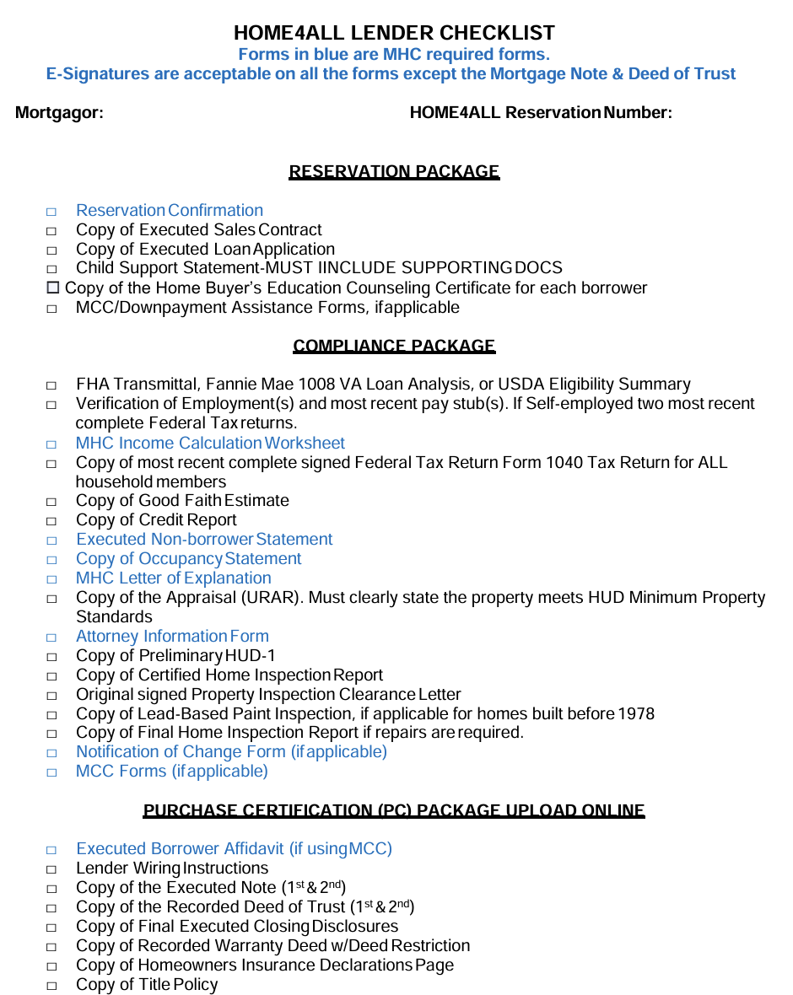

Slide 28
Environmental Review

Slide 29
Environmental Review Project Information
Process starts once the homebuyer has identified the eligible property.
– Not subject to Section 58.5
Airport Runway Clear Zones and Accident Potential Zones 24 CFR Part 51 Subpart D
Coastal Barrier Resources
Flood Insurance
Historic Preservation
MHC Environmental Impact Officer II
Shirley Thompson (Shirley.Thompson@mshc.com)

Slide 30
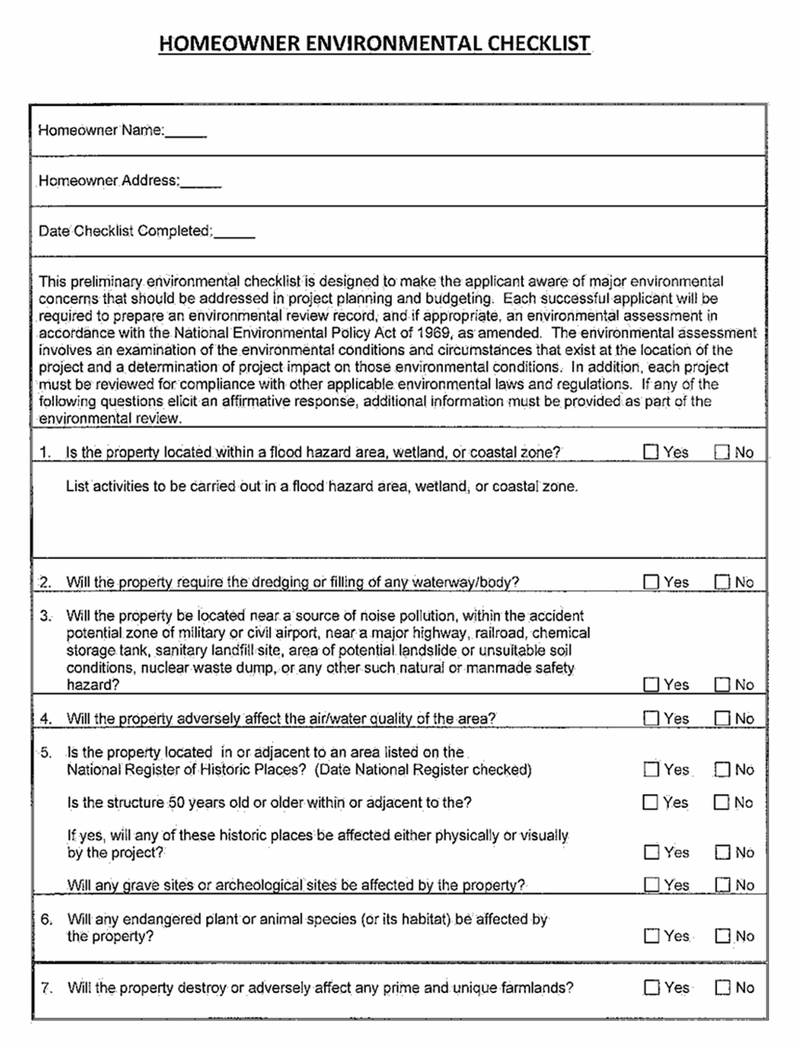

Slide 31
Homeowner Written Agreement
HOME funds can't be used to pay liens judgments or debt collection.
There cannot be any unfair advantages or undue benefits to the homebuyer or others associated with the sale/purchase of the home that would create a conflict of interest.
If there are fees charged at closing that are not fully disclosed on the LOAN ESTIMATE, the homebuyer has the right to question the fee and receive a consultation.
Homebuyer have the option of selecting the house of their choice, their realtor, and their financing institution (participating lender).
This period is enforced by a Deed Restriction executed at loan closing. A Deed Restriction is a document signed at closing to assure compliance with the period of affordability. The errors and omissions executed at closing by the homeowner should cover the execution of the Deed Restriction for any reason this document is not obtained at closing.
The home must be maintained as the primary residence throughout the period of affordability. FAILURE TO MAINTAIN THIS PROPERTY AS THE PRIMARY RESIDENCE WILL RESULT IN THE RECAPTURE OF HOME FUNDS. An annual verification of residency will be conducted by MHC.
A pro-rata amount of HOME funds received at the initial purchase of the house will be due to MHC if there is a sale, foreclosure or cash-out refinance during the period of affordability.

Slide 32

Questions?
For program resources visit www.mshomecorp.com

Slide 33
Thank you for attending
The Home4All Program overview.
Tina Jones, VP of Homeowner Preservation
If you are interested in partnering with the Home4All DPA Program, send an email to tina.jones@mshc.com or home4all@mshc.com
If you would like to have a presentation training as a service provider, lender or housing agency please reach out to at the above emails.

